Slide 1
Memory Management in C++
CS 201, Summer 2013

Slide 2
ADDITIONAL READING
Memory Management
  Chapter 10 Pearson Book
  http://www.learncpp.com/cpp-tutorial/79-the-stack-and-the-heap/
  http://www.learncpp.com/cpp-tutorial/67-introduction-to-pointers/
  http://www.learncpp.com/cpp-tutorial/68-pointers-arrays-and-pointer-arithmetic/
  http://www.learncpp.com/cpp-tutorial/69-dynamic-memory-allocation-with-new-and-delete/
  http://www.cplusplus.com/doc/tutorial/dynamic/

Slide 3
C++ Memory Management
C# and Java automatically handle memory management for you, for better or worse.
Memory Management is probably what separates C++ from C# and Java the most.
  C++ has pointers and references
  Java and C# only have references.

Slide 4
C++ Memory Management
Why are we using C++ in this course instead of Java or C#?
  In Computer Science coursework, we're interested in how a computer works; not necessarily a “software development” training program.
  It's good to know how things work at a “low-level” so that you understand how things can go wrong.
  Once you understand how things work, you can use “smart pointers” and such to handle the tricky memory things for you.

Slide 5
Types of memory errors
Invalid Memory Address
Memory Leaks
Missing Allocation
Uninitialized Memory Access
And More...
(cprogramming.com)

Slide 6
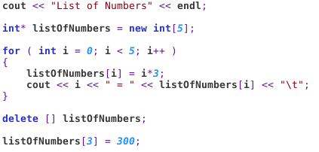
Invalid Memory Access
Usually when accessing unallocated (or freed up) memory.
  De-referencing a pointer to an invalid address
  Trying to assign data at an unallocated address
New dynamic array
Deleting dynamic array
Setting value in deleted array

Slide 7

Invalid Memory Access
Usually when accessing unallocated (or freed up) memory.
  De-referencing a pointer to an invalid address
  Trying to assign data at an unallocated address

Slide 8
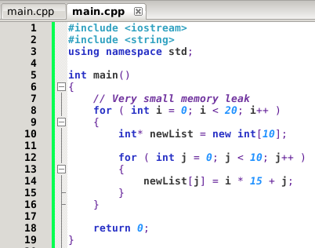
Memory Leaks
Memory is allocated but not deallocated (aka deleted, freed, etc.)
  Dangling Pointers
Creating a new dynamic array but delete never called!

Slide 9
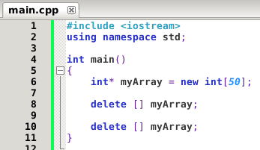
Missing Allocation
Freeing memory that has already been freed.
  Simple code...

Slide 10
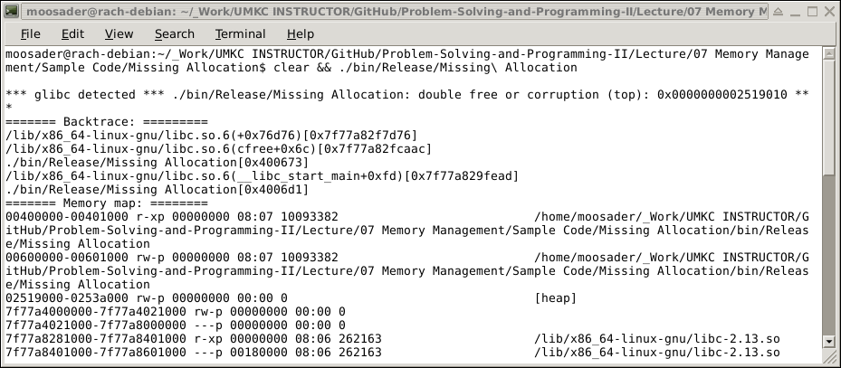
Missing Allocation
Freeing memory that has already been freed.
  Long error message

Slide 11
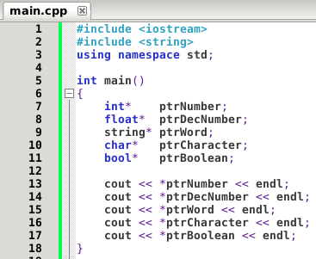
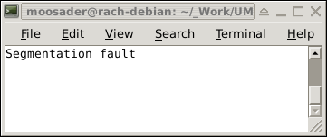
Uninitialized Memory Access
“Reading” a value of an uninitialized variable.

Slide 12
The Stack and the Heap
Different types of variables are stored in different types of memory.
Dynamic arrays are allocated in the Heap.
Local variables and parameters are allocated in the Stack.
(learncpp.com)

Slide 13
The Stack
The Stack has a more complex structure than the Heap.
  The size of the Stack is fixed, containing a sequence of memory addresses.
  No need to manually erase memory; it is “lazy-deleted” and will be overwritten when that space is needed*.
  When we declare variables, parameters*, or make a function call, this data is pushed onto the Stack.

Slide 14
The Stack
The stack is optimized, the CPU can manage the memory quickly – reads and writes.
Functions:
  When a function is called, its variables are pushed on the stack.
  When the function ends, its variables are popped off the stack (i.e., freed).
(gribblelab.org)

Slide 15
The Stack
The Stack grows and shrinks as variables are pushed on and popped off.
We don't manage memory ourself – handled automatically.
There is a limit on size of the stack.
Variables on the stack only exist while the function they belong to are running (are popped off afterwards).
(gribblelab.org)

Slide 16
The Heap – Dynamic Memory
The Heap is …
  Handles Dynamically Allocated memory (dynamic arrays)
  The allocated memory does not automatically get de-allocated; we must do that manually.
  Dynamically Allocated memory has to be accessed via a pointer.
  Large objects (arrays, classes, etc.) should be allocated here.
(learncpp.com)

Slide 17
The Heap – Dynamic Memory
The Heap is …
  No size restrictions on the Heap
  Variables created on the Heap are accessible anywhere in the program (i.e., passing pointers around!)
(gribblelab.org)

Slide 18
The Stack and the Heap
Think of the Stack as dealing with functions (local variables = variables inside a function)
And think of the Heap as dynamic memory / pointers!

Slide 19
The Stack and the Heap
The Stack is optimized & fast
It has a limited size
Automatically handles memory allocation/deallocation
Variables cannot be resized
Related to local variables

Slide 20
The Stack and the Heap
The Heap has no size limit
Variables can be accessed anywhere
Manual memory management
Can resize your variables

Slide 21
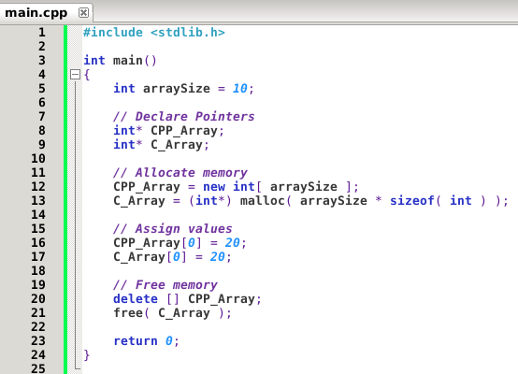
Allocating Memory
C++ vs. C
Only specify # of elements in C++
Have to allocate
# of elements x size of the data-type in C
C uses malloc and free. We won't use this in CS 201, but it's good to know what this is.

Slide 22
References
Cprogramming.com
How to Avoid, Find (and Fix) Memory Errors in your C/C++ Code
http://www.cprogramming.com/tutorial/memory_debugging_parallel_inspector.html
Learncpp.com
The stack and the heap
http://www.learncpp.com/cpp-tutorial/79-the-stack-and-the-heap/
Gribblelab.org
Memory : Stack vs Heap
http://gribblelab.org/CBootcamp/7_Memory_Stack_vs_Heap.html

